Slide 1
Project Title （小组成员）
陈意-Chen 杨楚凝-Nora 汪含之-Hanzhi

Slide 2
Translation of mouse motion track
（鼠标运动轨迹的转译）
In the following time, my teammates and I will cooperate with each other. Some of us will collect data by using software, and some of us will purchase all the materials needed for a big operation. In addition, we will carry out the preliminary construction as soon as possible, and try to find out the problems in the operation and solve them.
对鼠标轨迹的可视化，它能记录我们一天之中在电脑上的痕迹 ，对电脑的使用程度，以及会记录我们的日常上网的路径，可以体现我们对电脑的依赖使用程度，过度使用电脑的人鼠标路径会非常大的密集，而不怎么用电
脑的人圆就会非常大，我们觉得非常有趣。

Slide 3
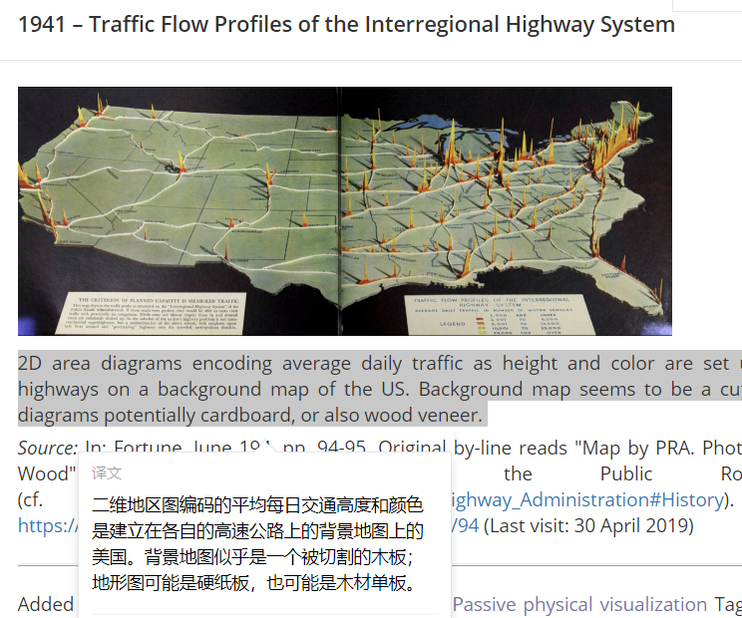
Inspiration
（灵感）
My inspiration comes from this art work, which expresses the road map of the plane in 3D. I think there is a route in the mouse movement, so I also want to express the mouse track in 3D.（我的灵感来自于这个艺术作品，它把平面的路线图通过3D的方式表达出来，我想鼠标运动的过程中也是有路线的，所以也想用3D的方式来表现鼠标轨迹。）

Slide 4
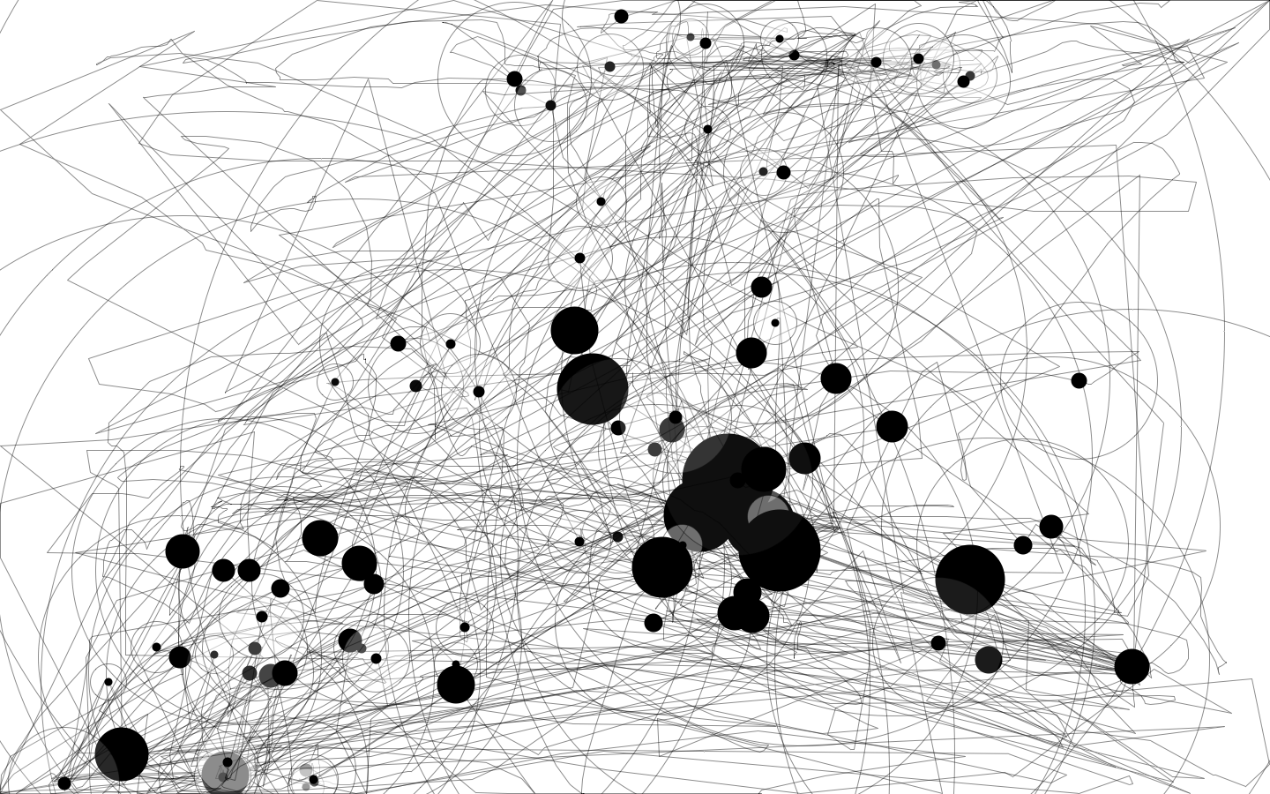
Our data is not a specific number, but a graph, a graph generated by IOgraph, which we will represent in 3D.
If it works, it will be suspended in mid-air.
我们的数据它不是具体的数字，而是一张图，一张由IOgraph（一款鼠标轨迹的记录软件）生成的图，我们会把这张图用3D的方式表现出来。如果顺利的话，它会被挂在半空中。

Slide 5
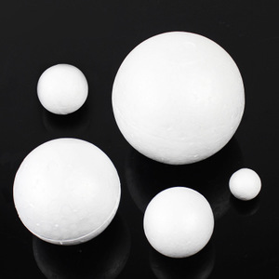
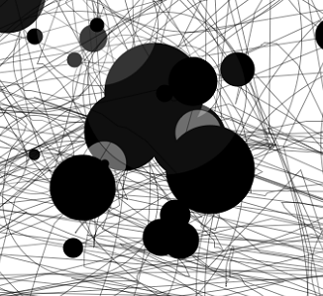
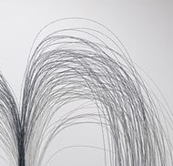
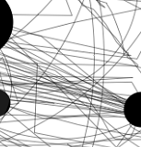
Foam balls represent black spots, and thin wire lines represent trajectories.
用泡沫球代表停留黑点，细的铁丝线代表轨迹。
like this
如下

Slide 6
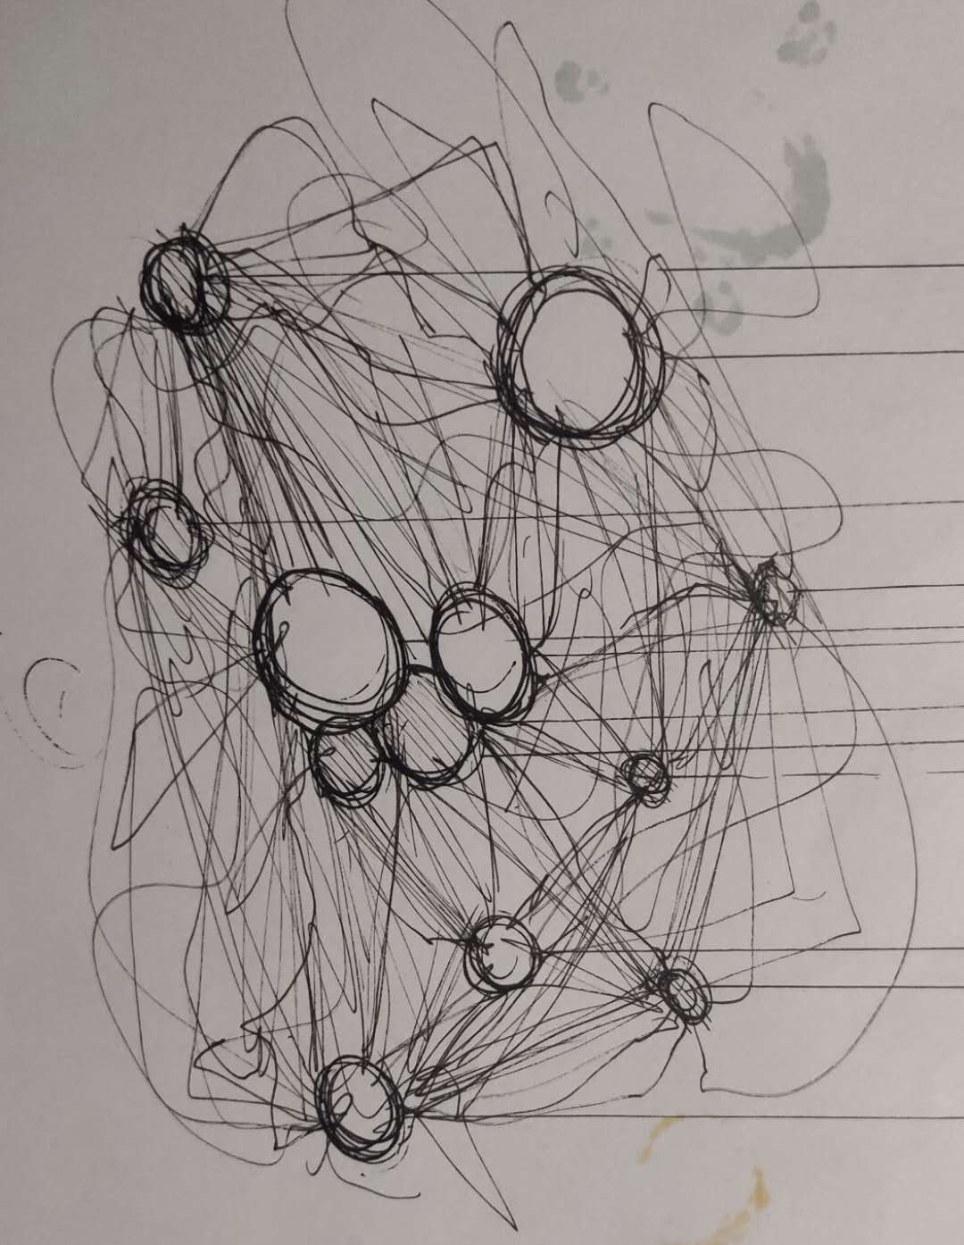
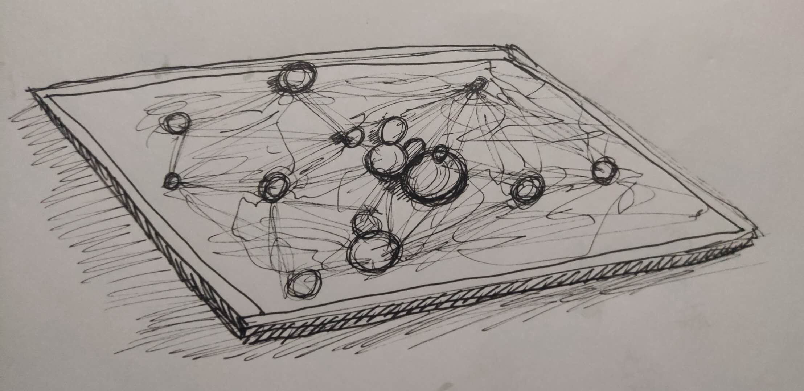
Form Sketches
形成草图
Sketches
plan B

Slide 7
Next job
In the following time, my teammates and I will cooperate with each other. Some of us will collect data by using software, and some of us will purchase all the materials needed for a big operation. In addition, we will carry out the preliminary construction as soon as possible, and try to find out the problems in the operation and solve them.
(在接下来的时间里，我和我的队友会分工合作，有人会收集利用软件收集数据，有人会购买好大作业需要的所有材料，并且我们会尽快进行初步的搭建工作，尽量发现作业的问题然后解决掉。)

Slide 9
Thank you

